Slide 1

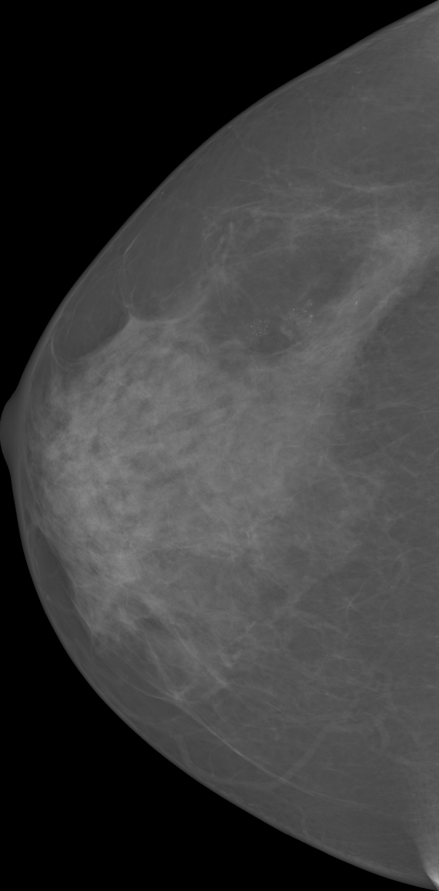
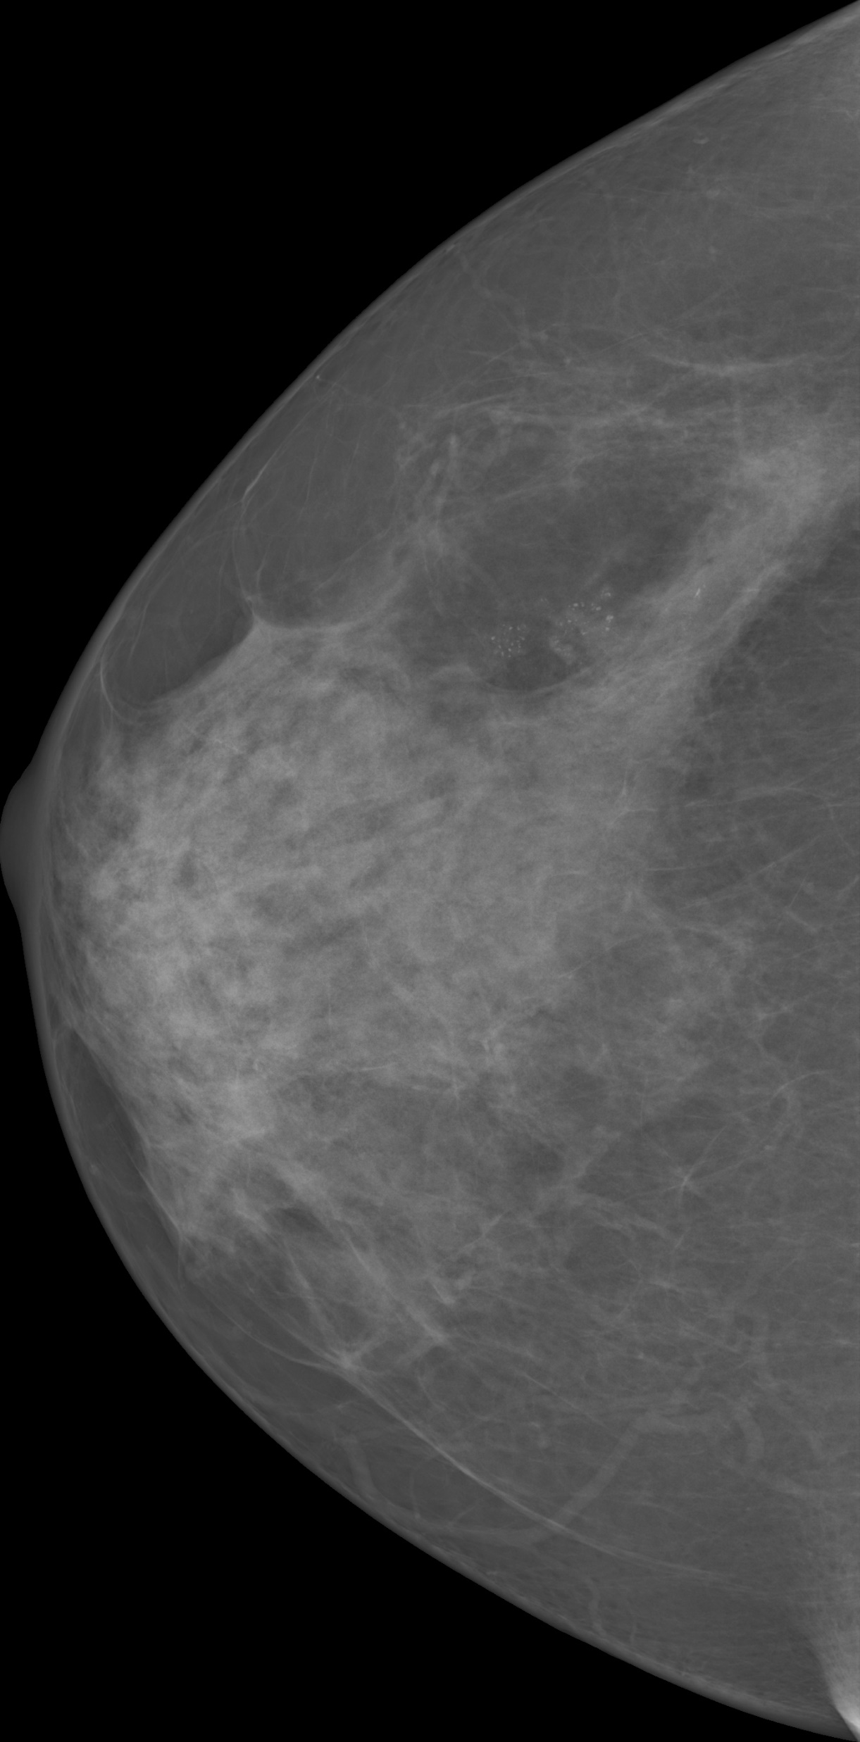
Segmented image
without redundant
background
Final result subsampled
¼ of original size
Original image
Thresholded Mask
CLAHE applied
(a)
(b)
(c)
(d)
(e)
Pre-processing

Slide 2
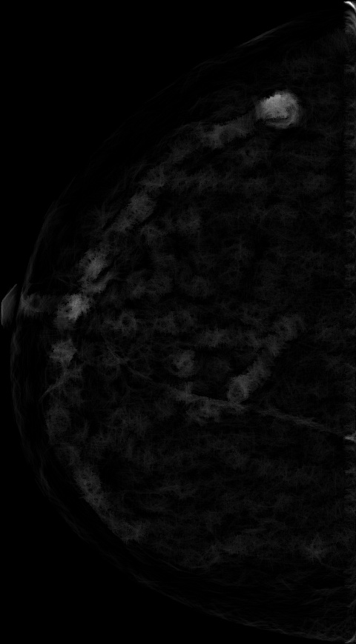
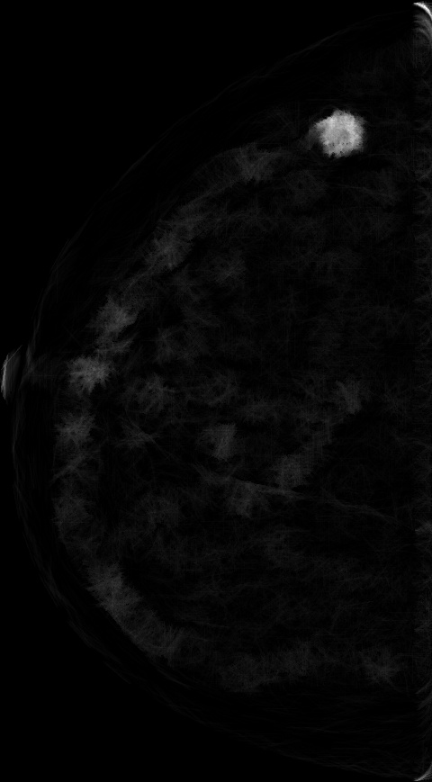

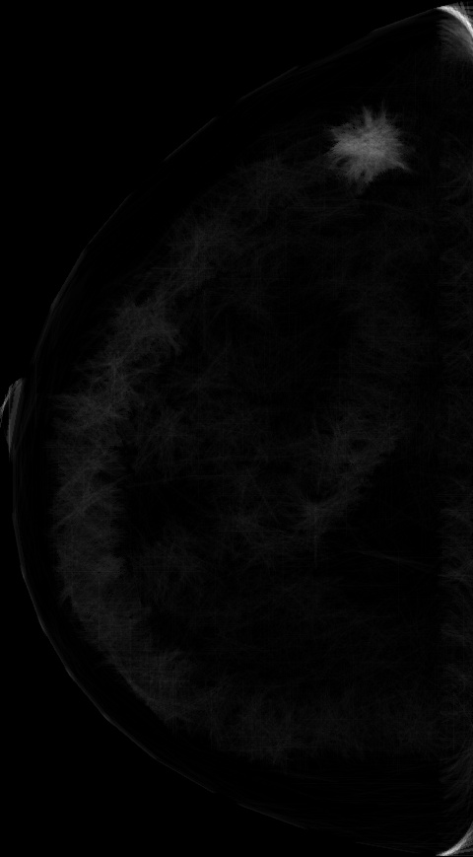
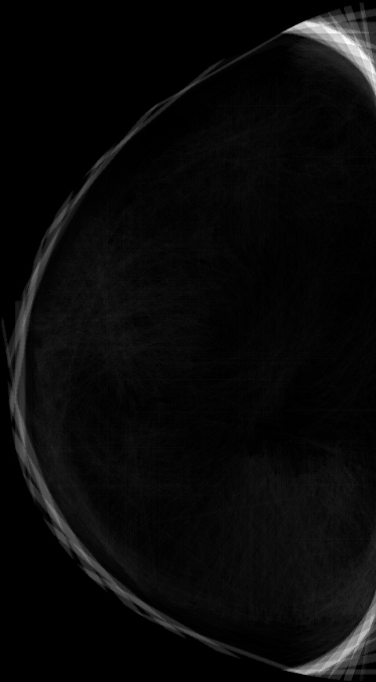
The image output from MMS
Scale 2
Scale 3
Scale 4
Scale 5
Scale 9
…
…
Pre-processed
Mean Shift Filter
…
…
Multi-scale Morphological Sifting (MMS) + Mean Shift Filter (MSF)

Slide 3
K-Means
Scale 2
Scale 3
Scale 4
Scale 5
Scale 9
…
…
Post-Processing
…
…
K-means + Post-processing

Slide 4
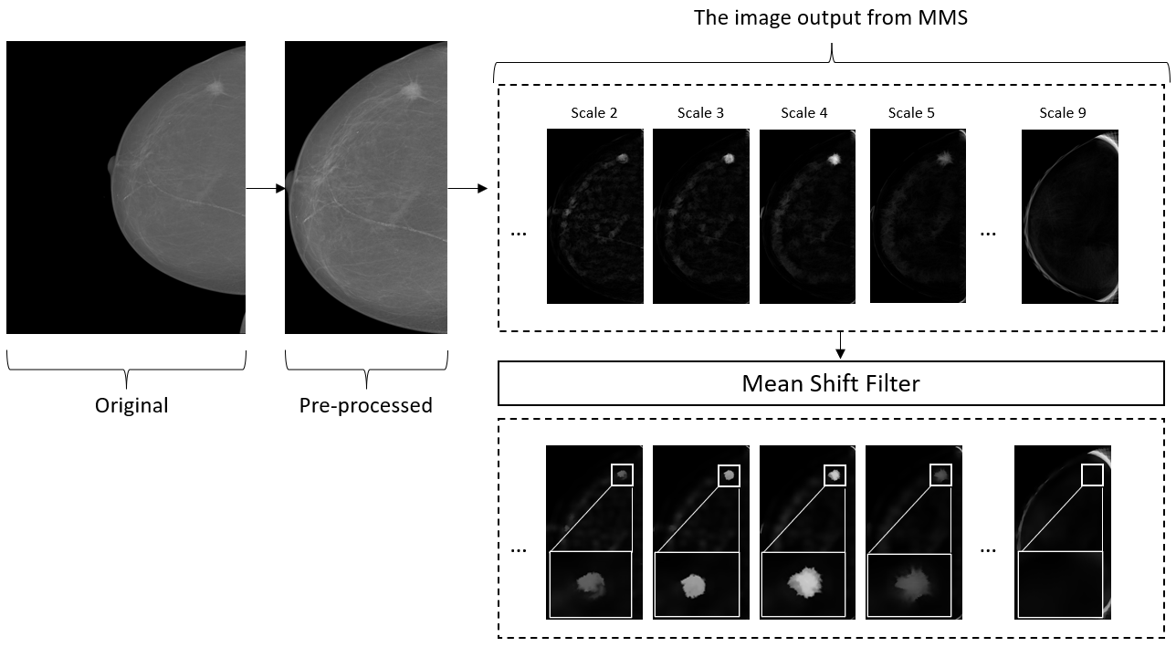
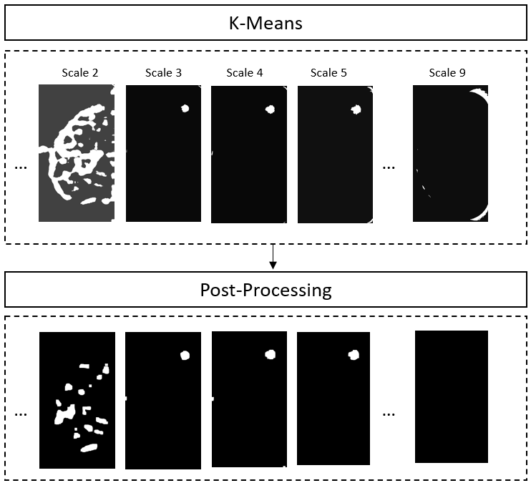
Full pipeline

Slide 5
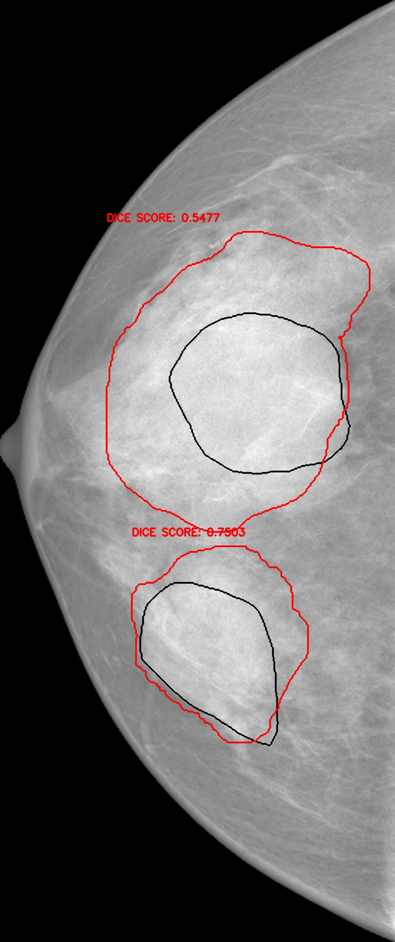
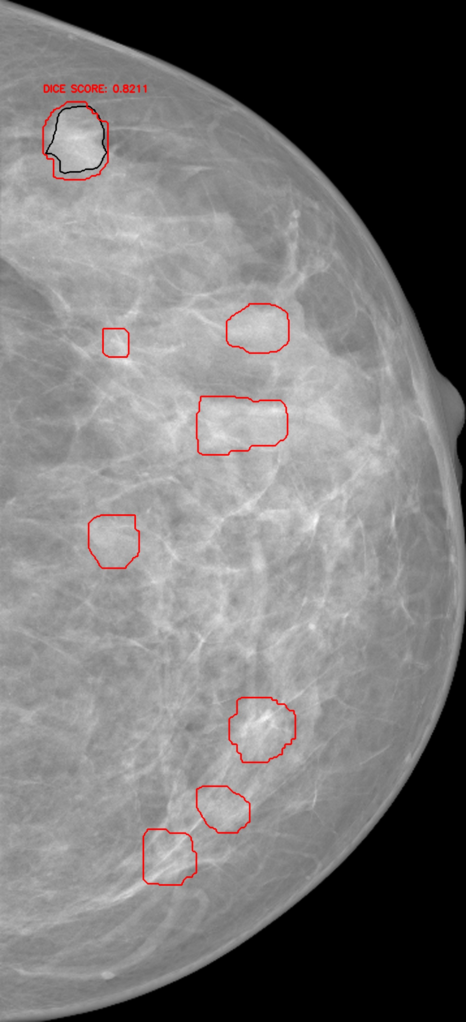
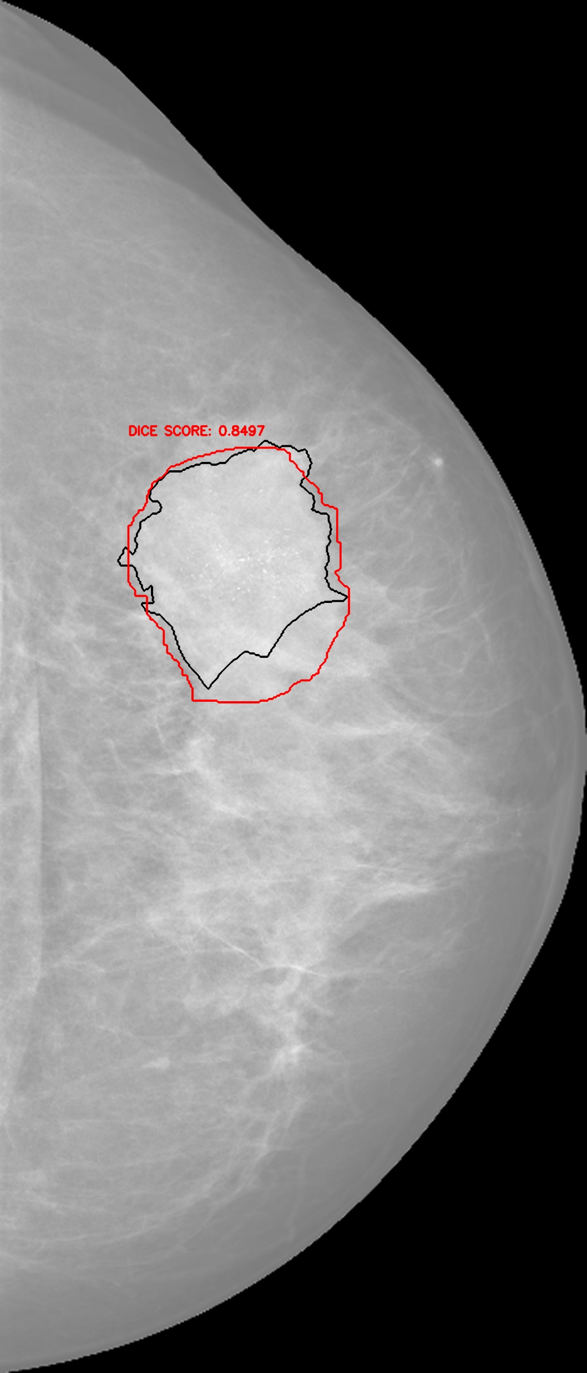
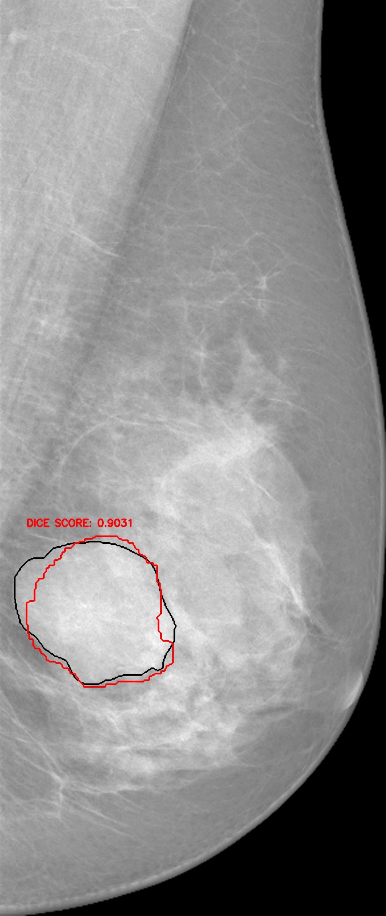
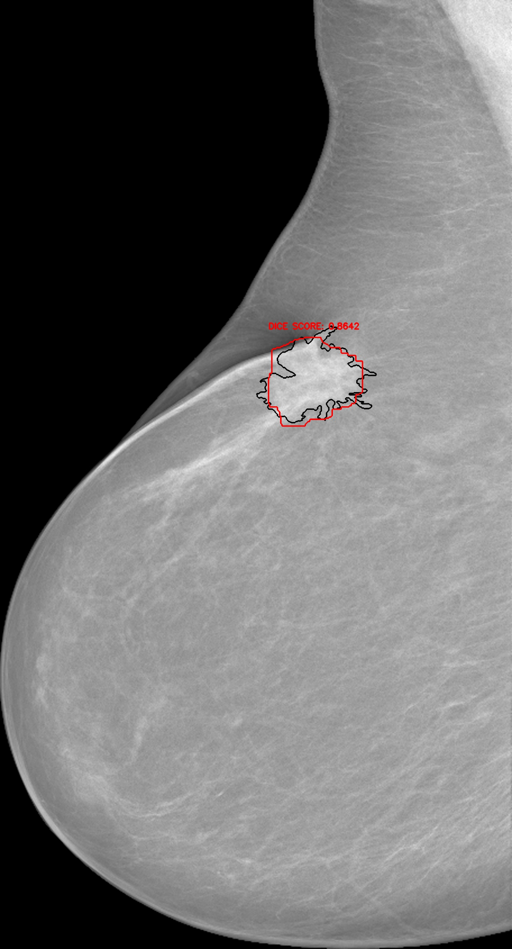
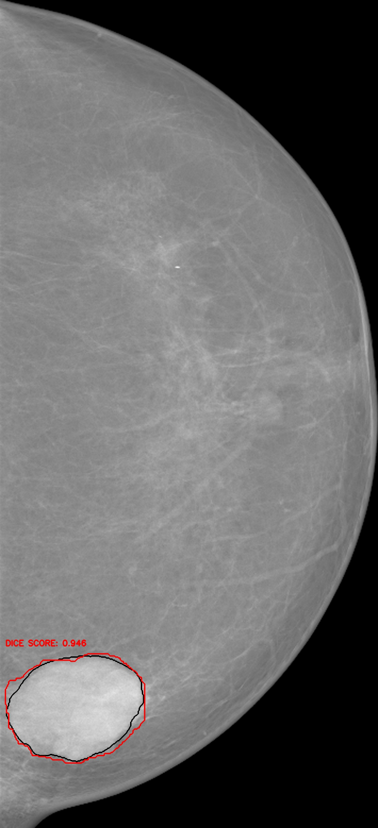
(b)
(d)
(f)
(a)
(c)
(e)
(g)
Sample results (please refer to visual result submission for detailed results)

